Slide 1
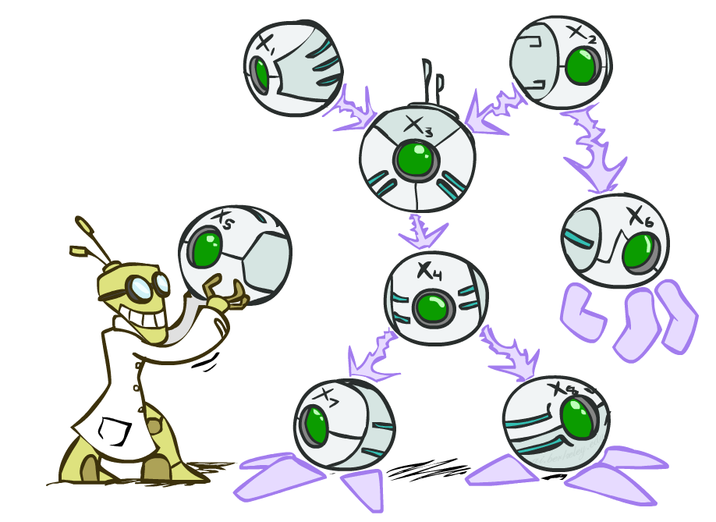
CSE 317: Artificial Intelligence
Bayes’ Nets
[These slides were created by Dan Klein and Pieter Abbeel for CS188 Intro to AI at UC Berkeley. All CS188 materials are available at http://ai.berkeley.edu.]
Notes:
Please retain proper attribution, including the reference to ai.berkeley.edu. Thanks!

Slide 2

Probabilistic Models
Models describe how (a portion of) the world works
Models are always simplifications
May not account for every variable
May not account for all interactions between variables
“All models are wrong; but some are useful.” – George E. P. Box
What do we do with probabilistic models?
We (or our agents) need to reason about unknown variables, given evidence
Example: explanation (diagnostic reasoning)
Example: prediction (causal reasoning)
Example: value of information
Notes:
George Box: All models are wrong; some of them are useful

Slide 3
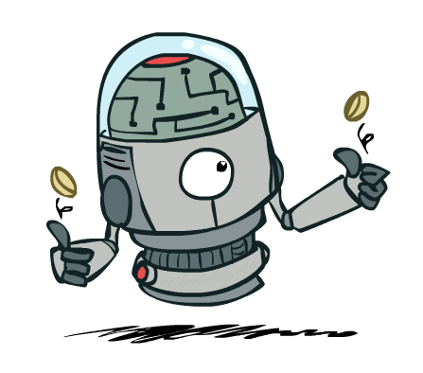
Independence

Slide 4
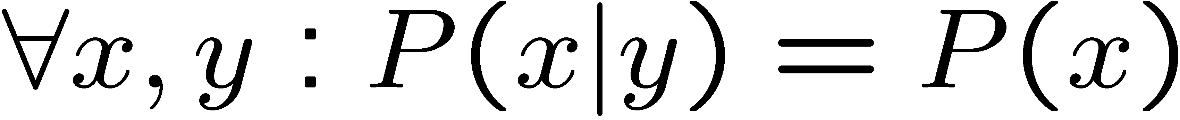
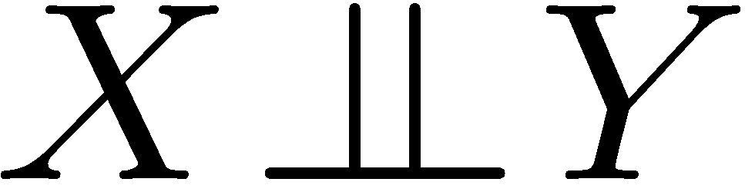
Independence
Two variables are independent if:
This says that their joint distribution factors into a product two simpler distributions
Another form:
We write:
Independence is a simplifying modeling assumption
Empirical joint distributions: at best “close” to independent
What could we assume for {Weather, Traffic, Cavity, Toothache}?

Slide 5
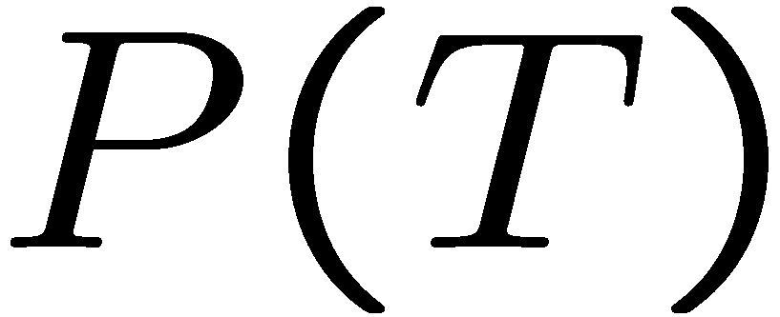
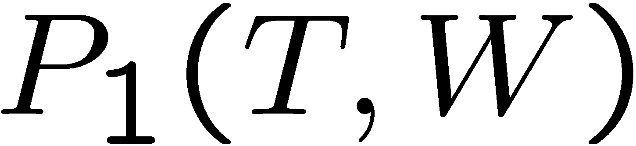
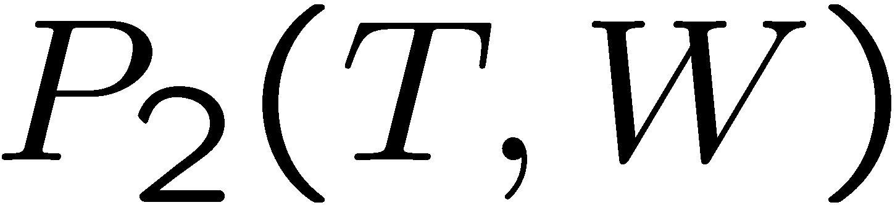
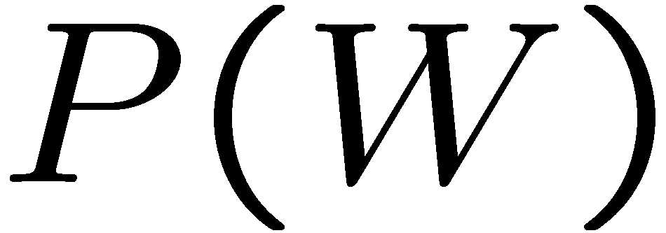
Example: Independence?
T | P
hot | 0.5
cold | 0.5
T | W | P
hot | sun | 0.4
hot | rain | 0.1
cold | sun | 0.2
cold | rain | 0.3
T | W | P
hot | sun | 0.3
hot | rain | 0.2
cold | sun | 0.3
cold | rain | 0.2
W | P
sun | 0.6
rain | 0.4

Slide 6


Example: Independence
N fair, independent coin flips:
H | 0.5
T | 0.5
H | 0.5
T | 0.5
H | 0.5
T | 0.5

Slide 7
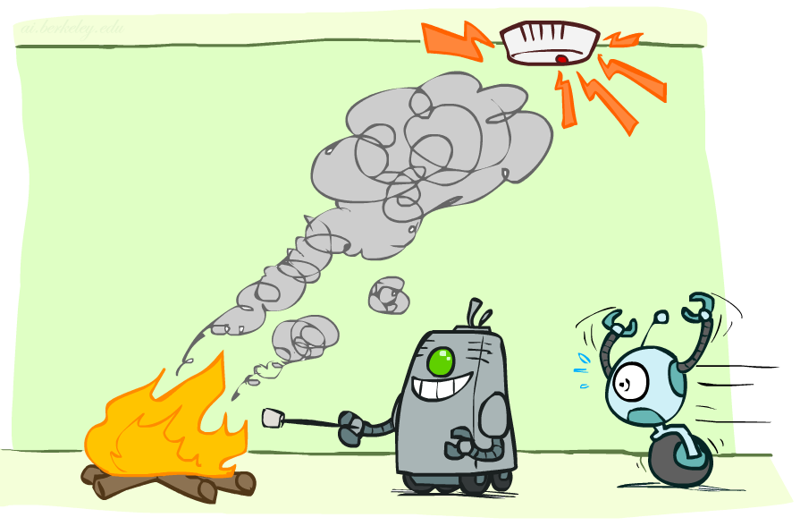
Conditional Independence

Slide 8
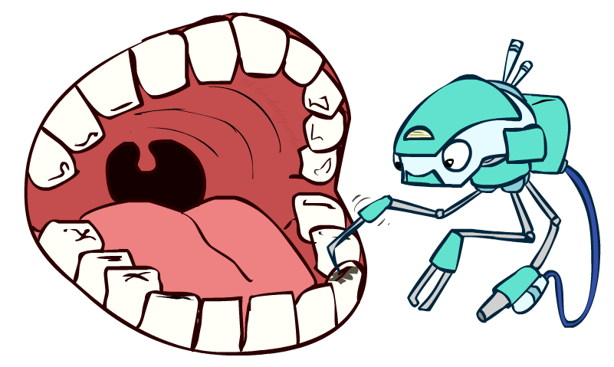
Conditional Independence
P(Toothache, Cavity, Catch)
If I have a cavity, the probability that the probe catches in it doesn't depend on whether I have a toothache:
P(+catch | +toothache, +cavity) = P(+catch | +cavity)
The same independence holds if I don’t have a cavity:
P(+catch | +toothache, -cavity) = P(+catch| -cavity)
Catch is conditionally independent of Toothache given Cavity:
P(Catch | Toothache, Cavity) = P(Catch | Cavity)
Equivalent statements:
P(Toothache | Catch , Cavity) = P(Toothache | Cavity)
P(Toothache, Catch | Cavity) = P(Toothache | Cavity) P(Catch | Cavity)
One can be derived from the other easily

Slide 9
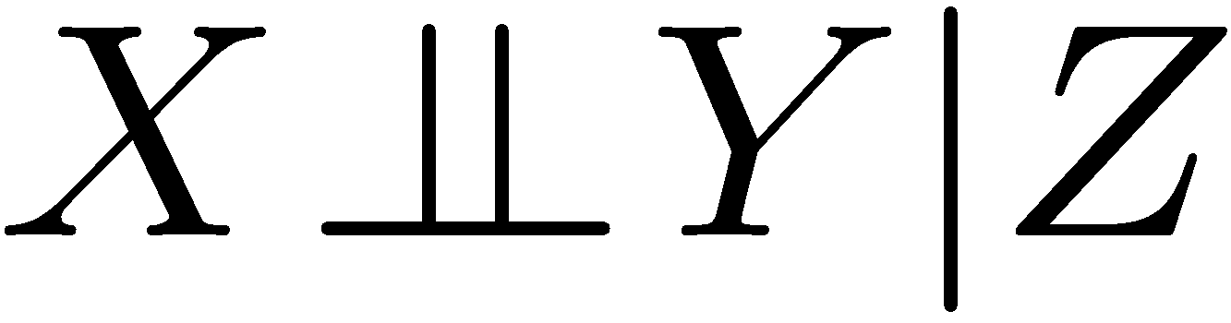
Conditional Independence
Unconditional (absolute) independence very rare (why?)
Conditional independence is our most basic and robust form of knowledge about uncertain environments.
X is conditionally independent of Y given Z
if and only if:
or, equivalently, if and only if

Slide 10
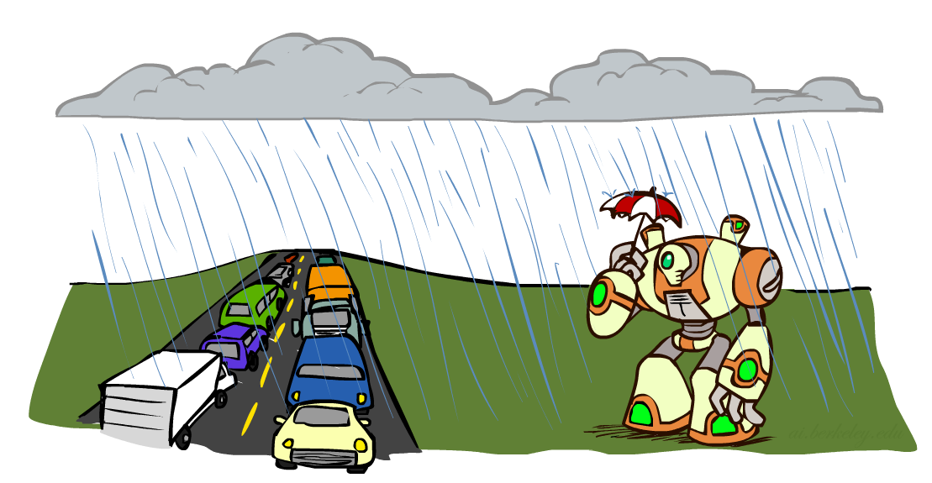
Conditional Independence
What about this domain:
Traffic
Umbrella
Raining

Slide 11

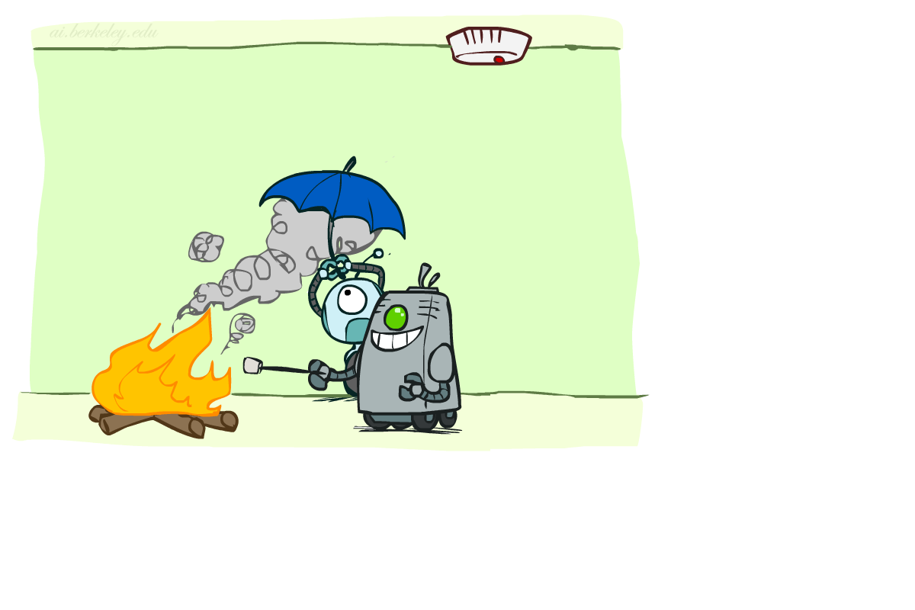
Conditional Independence
What about this domain:
Fire
Smoke
Alarm

Slide 12

Conditional Independence and the Chain Rule
Chain rule:
Trivial decomposition:
With assumption of conditional independence:
Bayes’nets / graphical models help us express conditional independence assumptions

Slide 13
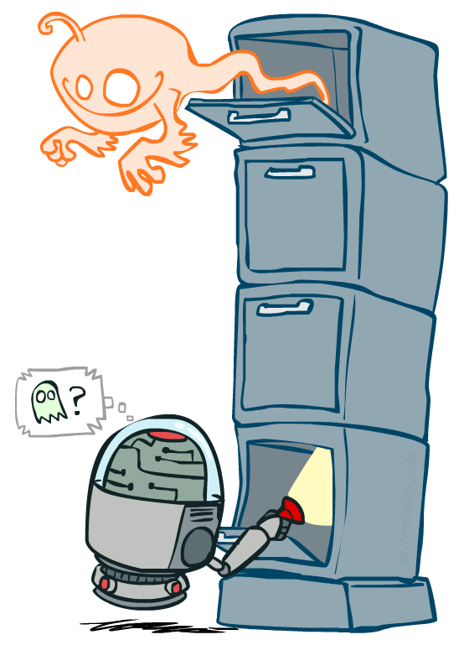
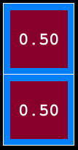
Ghostbusters Chain Rule
Each sensor depends only on where the ghost is
That means, the two sensors are conditionally independent, given the ghost position
T: Top square is red B: Bottom square is red G: Ghost is in the top
Givens:
P( +g ) = 0.5
P( -g ) = 0.5
P( +t | +g ) = 0.8 P( +t | -g ) = 0.4 P( +b | +g ) = 0.4 P( +b | -g ) = 0.8
P(T,B,G) = P(G) P(T|G) P(B|G)
T | B | G | P(T,B,G)
+t | +b | +g | 0.16
+t | +b | -g | 0.16
+t | -b | +g | 0.24
+t | -b | -g | 0.04
-t | +b | +g | 0.04
-t | +b | -g | 0.24
-t | -b | +g | 0.06
-t | -b | -g | 0.06

Slide 14
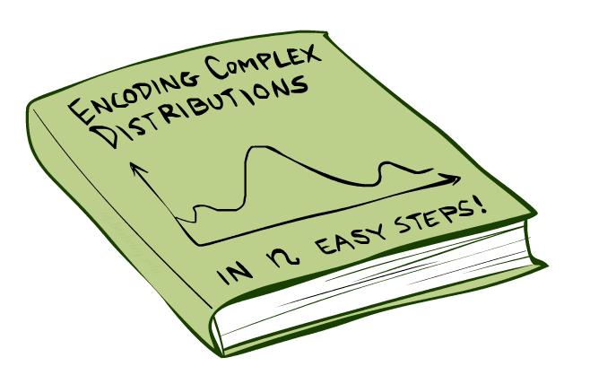
Bayes’Nets: Big Picture

Slide 15

Bayes’ Nets: Big Picture
Two problems with using full joint distribution tables as our probabilistic models:
Unless there are only a few variables, the joint is WAY too big to represent explicitly
Hard to learn (estimate) anything empirically about more than a few variables at a time
Bayes’ nets: a technique for describing complex joint distributions (models) using simple, local distributions (conditional probabilities)
More properly called graphical models
We describe how variables locally interact
Local interactions chain together to give global, indirect interactions

Slide 16
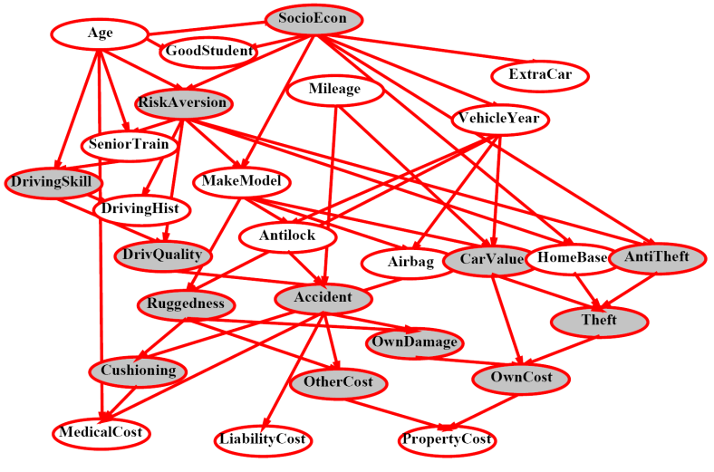
Example Bayes’ Net: Insurance

Slide 17
Example Bayes’ Net: Car

Slide 18
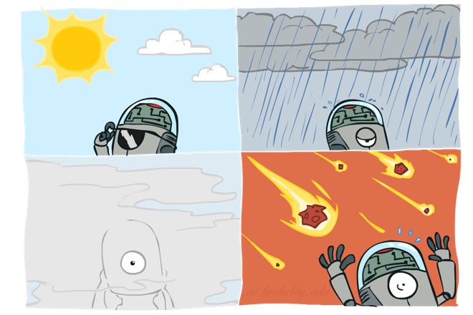
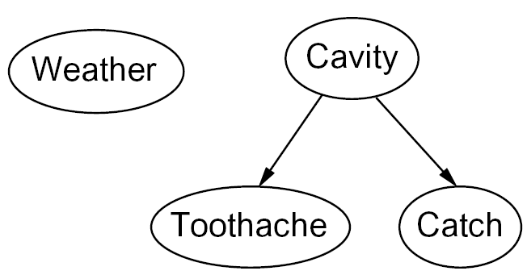
Graphical Model Notation
Nodes: variables (with domains)
Can be assigned (observed) or unassigned (unobserved)
Arcs: interactions
Similar to CSP constraints
Indicate “direct influence” between variables
Formally: encode conditional independence (more later)
For now: imagine that arrows mean direct causation (in general, they don’t!)

Slide 19
Example: Coin Flips
N independent coin flips
No interactions between variables: absolute independence
X₁
X₂
X_{n}

Slide 20
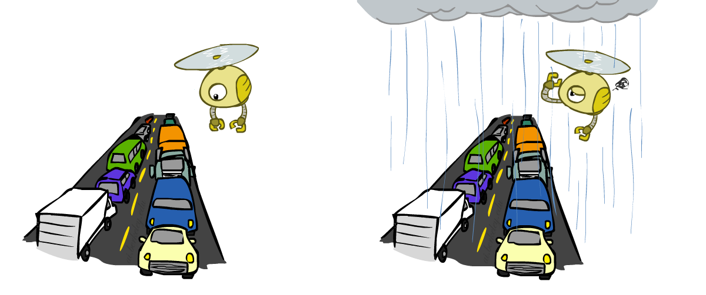
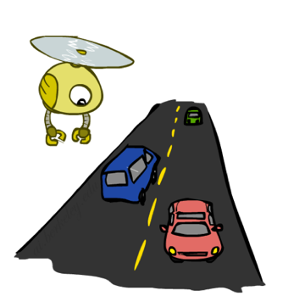
Example: Traffic
Variables:
R: It rains
T: There is traffic
Model 1: independence
Why is an agent using model 2 better?
Model 2: rain causes traffic
R
R
T
T

Slide 21
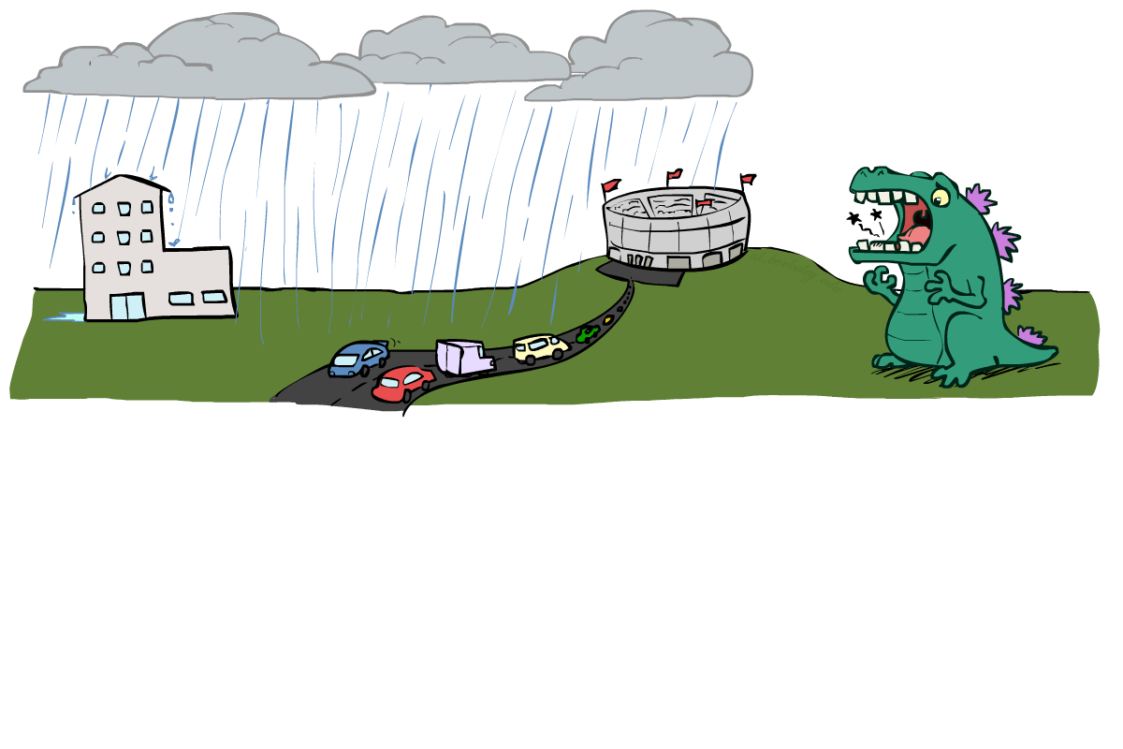
Example: Traffic II
Let’s build a causal graphical model!
Variables
T: Traffic
R: It rains
L: Low pressure
D: Roof drips
B: Ballgame
C: Cavity

Slide 22
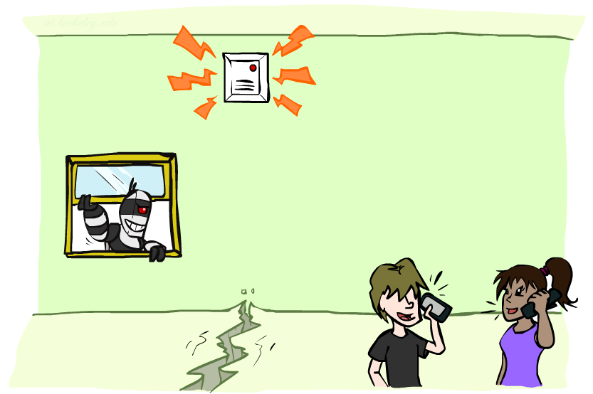
Example: Alarm Network
Variables
B: Burglary
A: Alarm goes off
M: Mary calls
J: John calls
E: Earthquake!

Slide 23
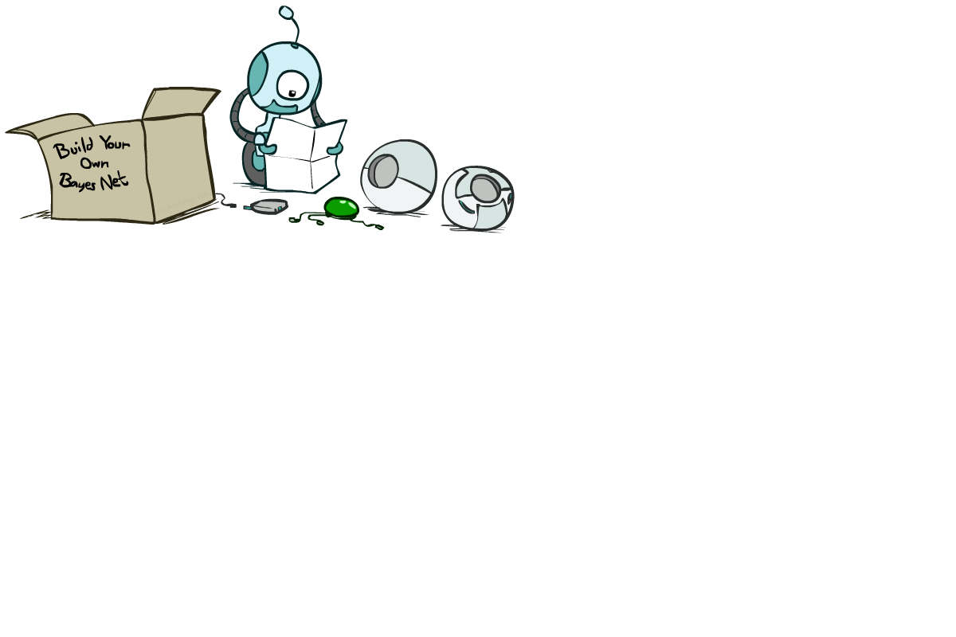
Bayes’ Net Semantics

Slide 24
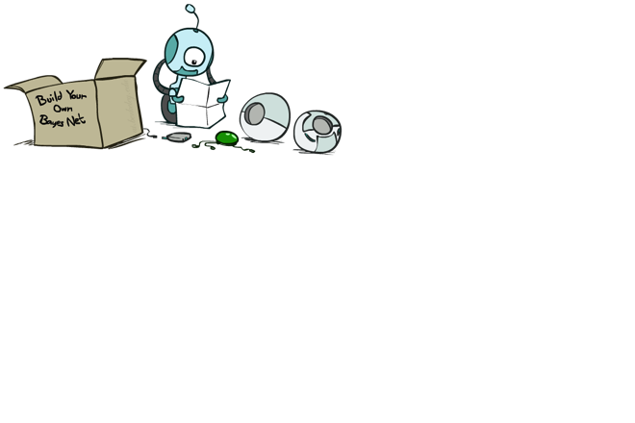
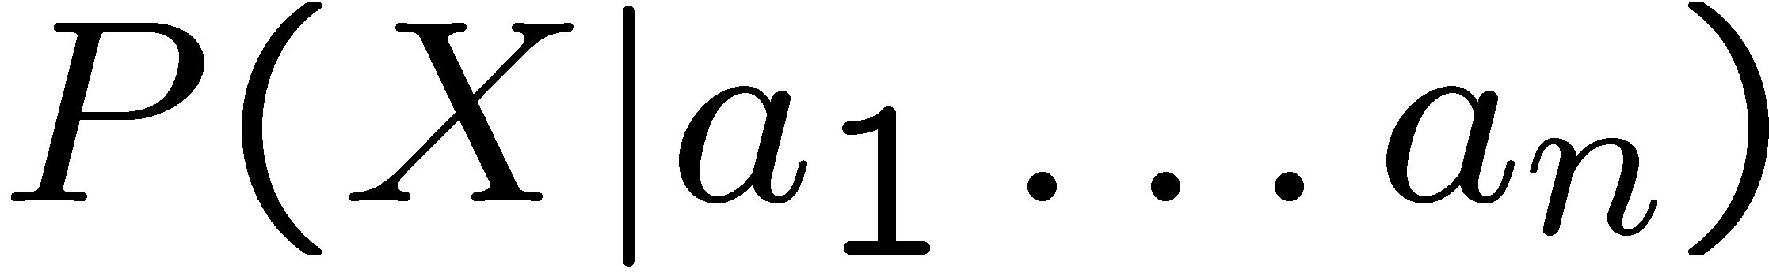
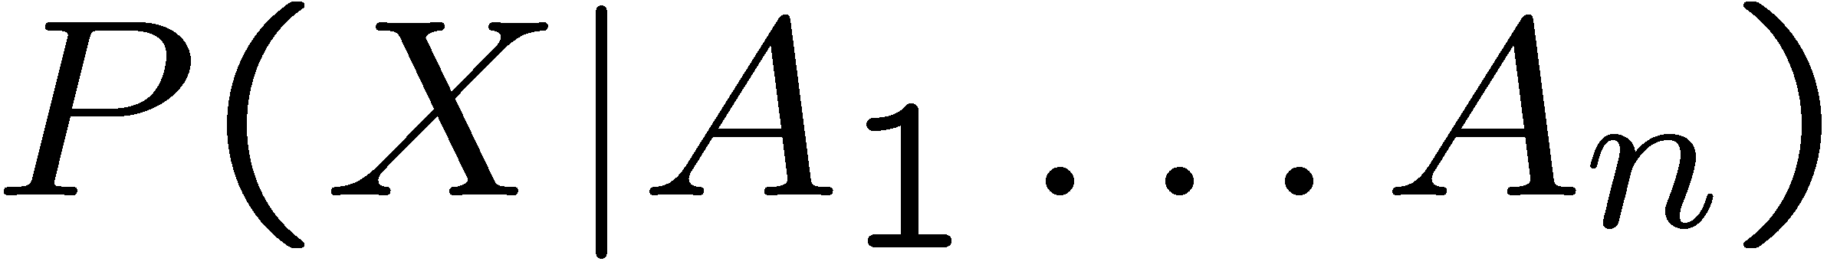
Bayes’ Net Semantics
A set of nodes, one per variable X
A directed, acyclic graph
A conditional distribution for each node
A collection of distributions over X, one for each combination of parents’ values
CPT: conditional probability table
Description of a noisy “causal” process
A₁
A_{n}
X
A Bayes net = Topology (graph) + Local Conditional Probabilities

Slide 25
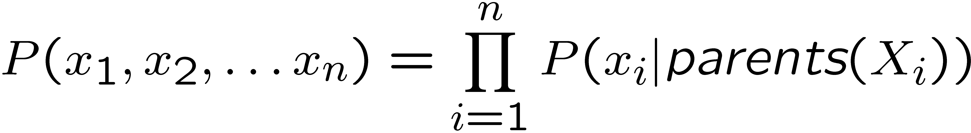
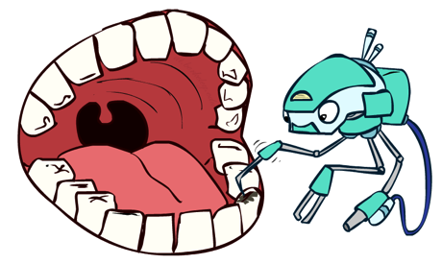
Probabilities in BNs
Bayes’ nets implicitly encode joint distributions
As a product of local conditional distributions
To see what probability a BN gives to a full assignment, multiply all the relevant conditionals together:
Example:

Slide 26
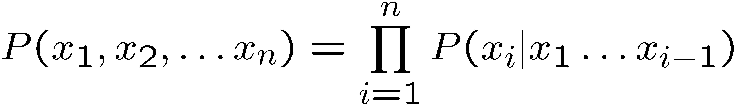
Probabilities in BNs
Why are we guaranteed that setting
results in a proper joint distribution?
Chain rule (valid for all distributions):
Assume conditional independences:
→ Consequence:
Not every BN can represent every joint distribution
The topology enforces certain conditional independencies

Slide 27
Example: Coin Flips
X₁
X₂
X_{n}
h | 0.5
t | 0.5
h | 0.5
t | 0.5
h | 0.5
t | 0.5
Only distributions whose variables are absolutely independent can be represented by a Bayes’ net with no arcs.
Notes:
demo

Slide 28



Example: Traffic
R
+r | 1/4
-r | 3/4
+r | +t | 3/4
 | -t | 1/4
T
-r | +t | 1/2
 | -t | 1/2
Notes:
demo

Slide 29

Example: Alarm Network
B | P(B)
+b | 0.001
-b | 0.999
E | P(E)
+e | 0.002
-e | 0.998
Burglary
Earthquake
Alarm
B | E | A | P(A|B,E)
+b | +e | +a | 0.95
+b | +e | -a | 0.05
+b | -e | +a | 0.94
+b | -e | -a | 0.06
-b | +e | +a | 0.29
-b | +e | -a | 0.71
-b | -e | +a | 0.001
-b | -e | -a | 0.999
John calls
Mary calls
A | J | P(J|A)
+a | +j | 0.9
+a | -j | 0.1
-a | +j | 0.05
-a | -j | 0.95
A | M | P(M|A)
+a | +m | 0.7
+a | -m | 0.3
-a | +m | 0.01
-a | -m | 0.99
Notes:
demo

Slide 30

Example: Traffic
Causal direction
R
+r | 1/4
-r | 3/4
+r | +t | 3/16
+r | -t | 1/16
-r | +t | 6/16
-r | -t | 6/16
+r | +t | 3/4
 | -t | 1/4
T
-r | +t | 1/2
 | -t | 1/2

Slide 31
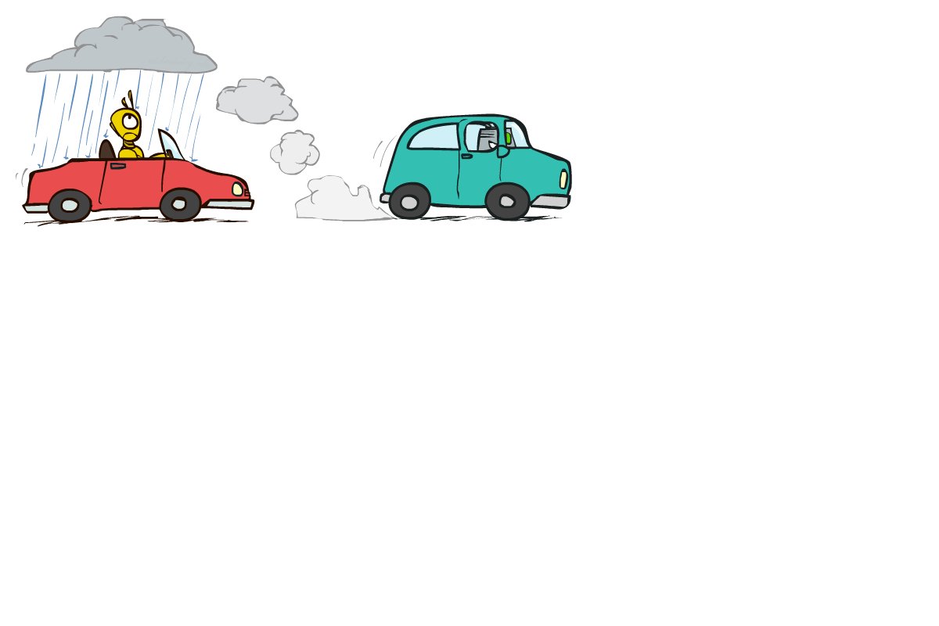

Example: Reverse Traffic
Reverse causality?
T
+t | 9/16
-t | 7/16
+r | +t | 3/16
+r | -t | 1/16
-r | +t | 6/16
-r | -t | 6/16
+t | +r | 1/3
 | -r | 2/3
R
-t | +r | 1/7
 | -r | 6/7

Slide 32
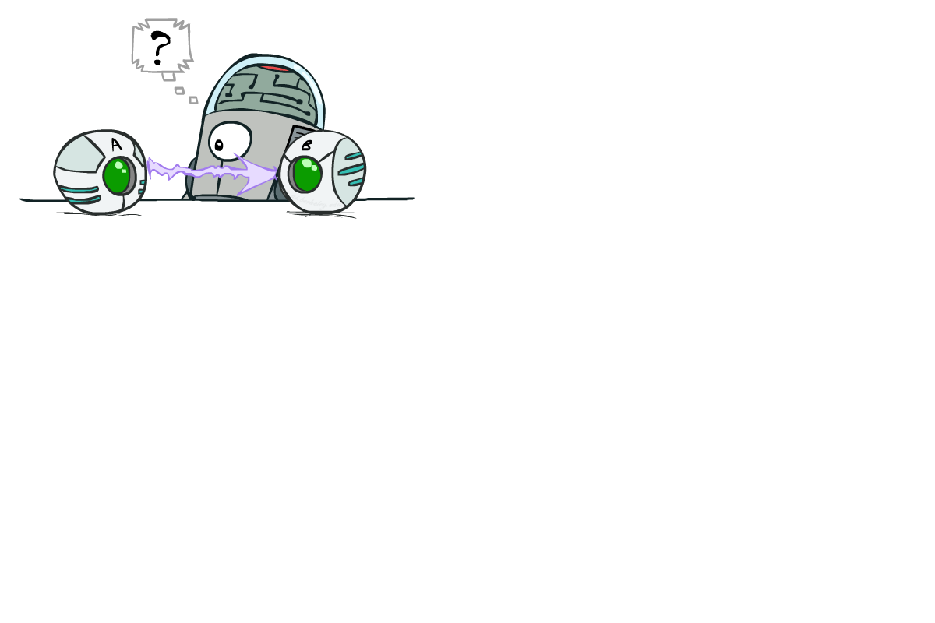
Causality?
When Bayes’ nets reflect the true causal patterns:
Often simpler (nodes have fewer parents)
Often easier to think about
Often easier to elicit from experts
BNs need not actually be causal
Sometimes no causal net exists over the domain (especially if variables are missing)
E.g. consider the variables Traffic and Drips
End up with arrows that reflect correlation, not causation
What do the arrows really mean?
Topology may happen to encode causal structure
Topology really encodes conditional independence

Slide 33

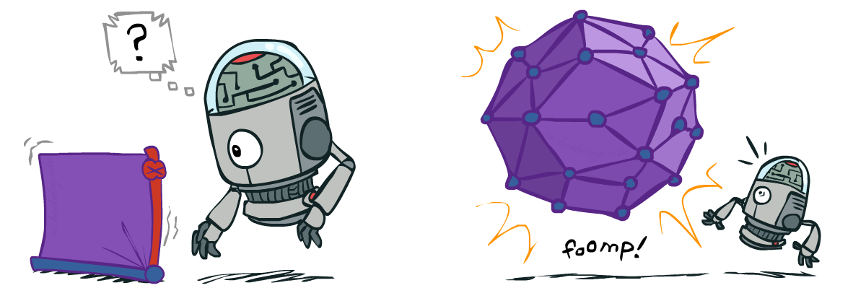
Size of a Bayes’ Net
How big is a joint distribution over N Boolean variables?
2^{N}
How big is an N-node net if nodes have up to k parents?
O(N * 2^{k+1})
Both give you the power to calculate
BNs: Huge space savings!
Also easier to elicit local CPTs
Also faster to answer queries (coming)

Slide 34
Bayes’ Nets
So far: how a Bayes’ net encodes a joint distribution
Next: how to answer queries about that distribution
Today:
First assembled BNs using an intuitive notion of conditional independence as causality
Then saw that key property is conditional independence
Main goal: answer queries about conditional independence and influence
After that: how to answer numerical queries (inference)

